Slide 1
Sentiment Analysis in Twitter
Weiheng Li

Slide 2
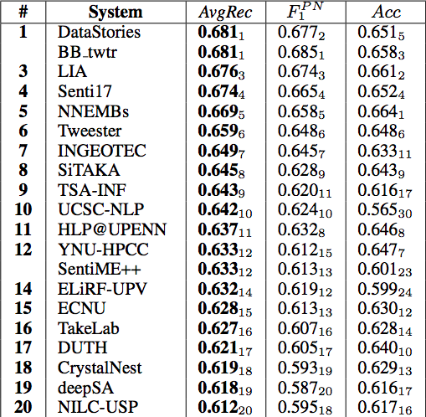
SemEval-2017 Task 4 subtask A
Message Polarity Classification: Given a message, classify whether the message is of positive, negative, or neutral sentiment.
Sentiment analysis in Twitter is a particularly challenging task, because of the informal and “creative” writing style, with improper use of grammar, figurative language, misspellings and slang.

Slide 3
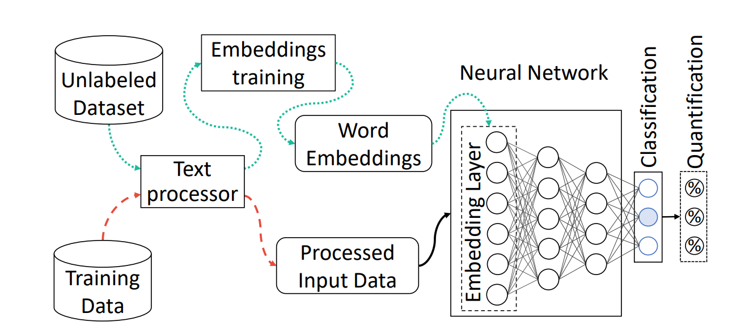

Slide 4
Tokenizer
Package ekphrasis
Social Tokenizer. A text tokenizer geared towards social networks (Facebook, Twitter...), which understands complex emoticons, emojis and other unstructured expressions like dates, times and more.
Word Segmentation. You can split a long string to its constituent words. Suitable for hashtag segmentation.
Spell Correction. You can replace a misspelled word, with the most probable candidate word.
Customization. Taylor the word-segmentation, spell-correction and term identification, to suit your needs.

Slide 5
Word2vector
A big dataset of 330M English Twitter messages, gathered from 12/2012 to 07/2016
Generate word embedding with more than 660k words
[ 2 318641 25 18639 407 743 6 87 317 49
3942 47 1143 795 111 25 11 396 4907 15
922 26 832 692 6 3 0 0 0 0
0 0 0 0 0 0 0 0 0 0
0 0 0 0 0 0 0 0 0 0]
Every word is expressed as a 300 dimension vector, using GloVe (Pennington et al., 2014)

Slide 6
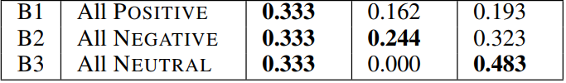
Dataset
Provided by SemEval-2017 competition Task 4
44613 training data
4957 testing data
Evaluation macro-average (f1 score) across the three classes

Slide 7
Prior work and trending
Tackled using hand-crafted features
Using Classifiers such as Naive Bayes or Support Vector Machines (SVM).
Redundant and missing features
Using Neural network is getting popular
Sentence is far simple than image so needn’t too many layer to train.
Preprocessing is also important

Slide 8
To find best combination of different layer
Input | (None, 50)
Embedding Layer
Convolutional Layer
MaxPooling Layer
LSTM Layer
BiLSTM Layer
Attention Layer
Dropout Layer
Merge Layer
GaussianNoise Layer
embedding | (None, 50, 300)
convolution | (None, 50, 300)
MaxPooling | (None, 12, 300)
BiLSTM1 | (None, 50, 300)
BiLSTM2 | (None, 50, 300)
Attention | (None, 300)
Attention | (None, 300)
Merge | (None, 600)
Dense | (None, 3)

Slide 9
Conv+MaxPooling Layer
Convolutional layer | Input | (None, 50, 300)
 | output | (None, 50, 300)
MaxPooling layer | Input | (None, 50, 300)
 | output | (None, 12, 300)
Accelerate training speed and sometimes better performance

Slide 10
Embedding Layer
Embedding layer | Input | (None, 50)
 | output | (None, 50, 300)
Gaussian Noise layer | Input | (None, 50, 300)
 | output | (None, 50, 300)
Dropout layer | Input | (None, 50, 300)
 | output | (None, 50, 300)
Insert word vector information into sentence information

Slide 11
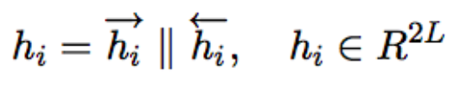
LSTM/BiLSTM Layer (return sequences)
LSTM/BiLSTM layer1 | Input | (None, 50, 300)
 | output | (None, 50, 300)
Extract order information in one or two direction

Slide 12
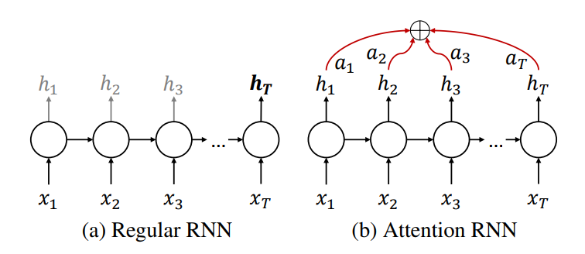
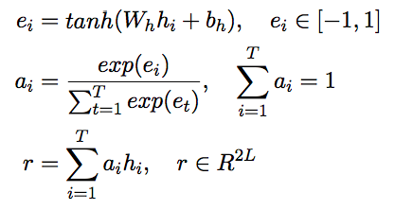
Attention Layer
Attention layer1 | Input | (None, 50, 300)
 | output | (None, 300)

Slide 13
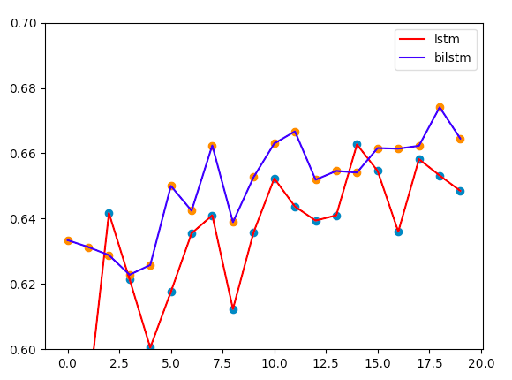
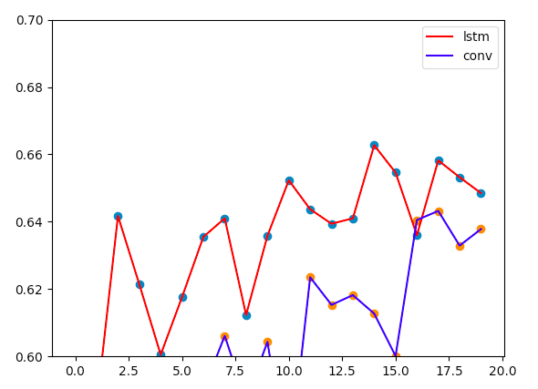
Experiment and result

Slide 14
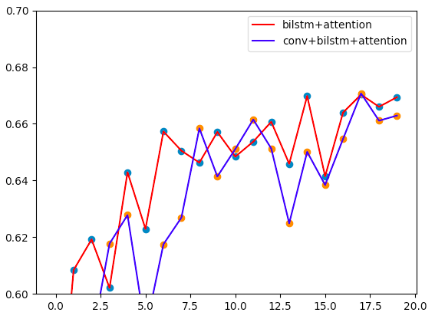
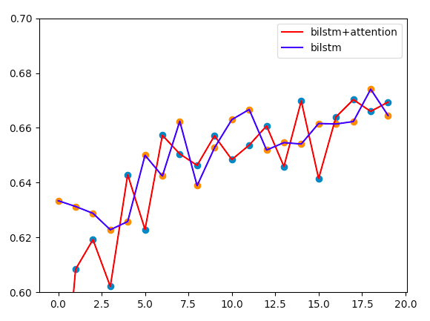
Experiment and result

Slide 15
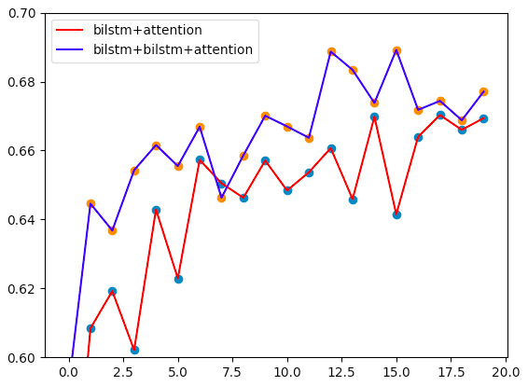
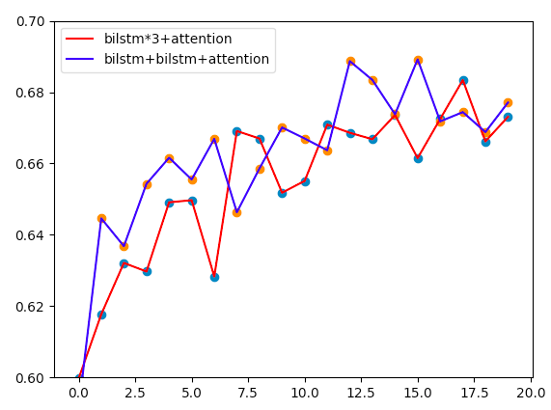
Experiment and result

Slide 16
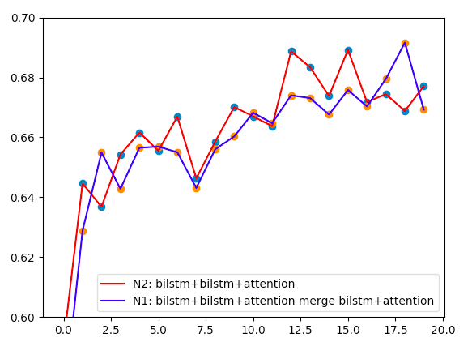
Experiment and result
Highest f1 point: 0.691 much better than 1st in the competition.
N1 structure best score: 0.692
N2 structure best score: 0.689

Slide 17
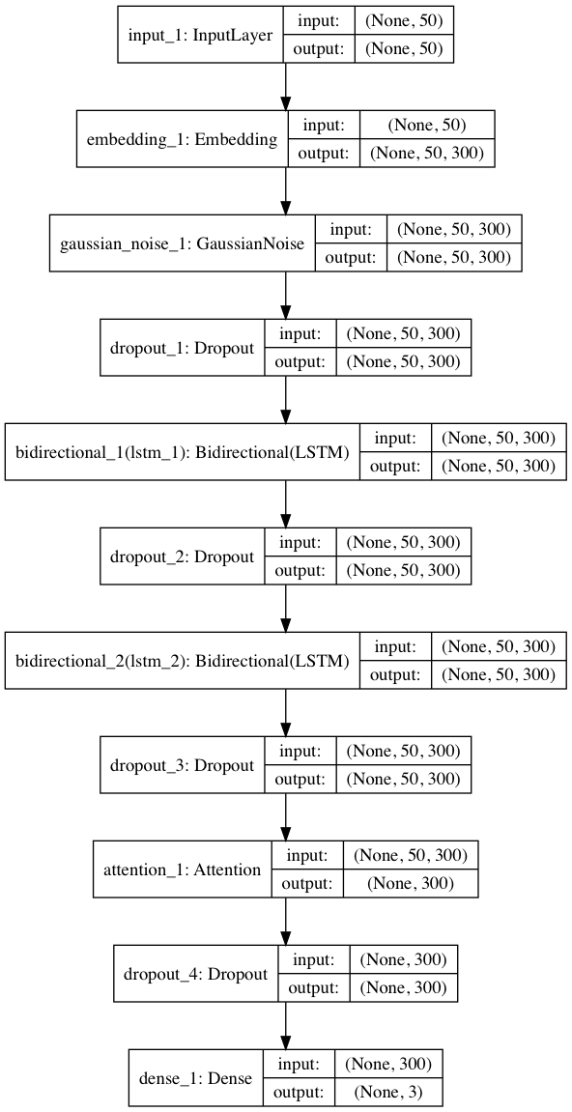
Structure of N1 and N2

Slide 18
Extension
Hardware limitation: only 20 epoch per structure (1-10h) can’t wait till stable.
Some new structure to be test.
Update new data for preprocess
As a sub-NN to play in other task.

